Slide 1

MICROPROCESSORS AND MICROCONTROLLERS (BECE204L)
DR. NAUSHAD MANZOOR LASKAR
ASSISTANT PROFESSOR SG-1
SCHOOL OF ELECTRONICS ENGINEERING (SENSE)
VELLORE INSTITUTE OF TECHNOLOGY, VELLORE

Slide 2
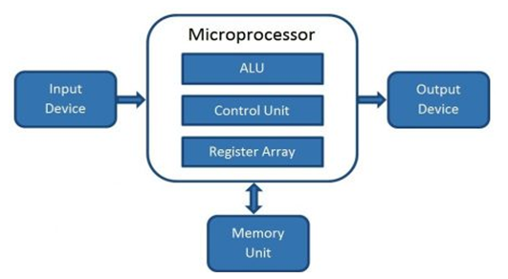
Generalized Block Diagram
controls the computer and performs all calculations.
ability to perform various operations quickly
ALU performs arithmetic and logical operations on the data received from an input device or memory
Communication through I/O Port/Bus
Register array consists of registers identified by letters like B, C, D, E, H, L, and accumulator.
Control unit controls the instructions and flow of data within the computer
stores programs and data required by the processor

Slide 3
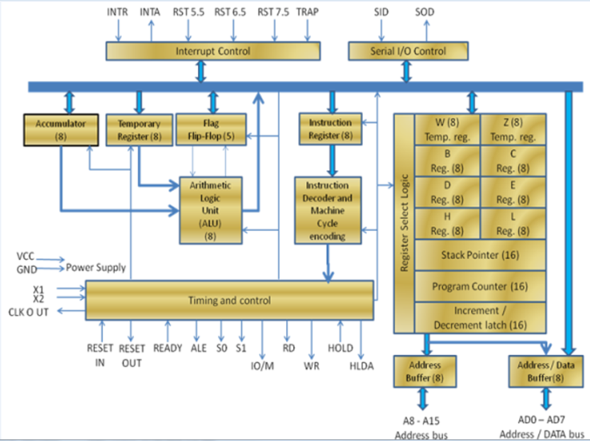
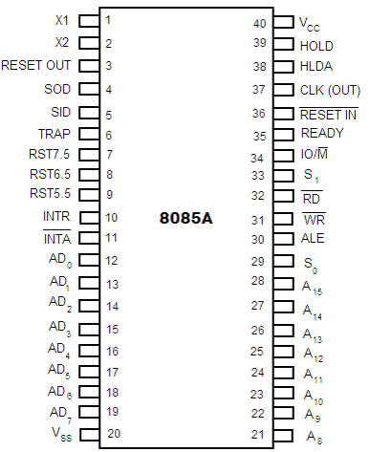
8085 Microprocessor: A brief study
8 bit NMOS MICROPROCESSOR USED IN MANY MOBILES, WASHING MACHINES ETC.
Pin Diagram
Architecture

Slide 4
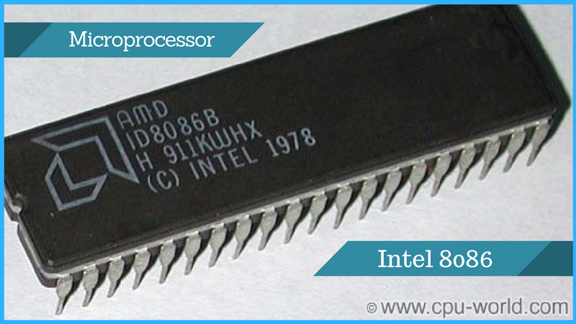
MODULE 2: MICROPROCESSOR ARCHITECTURE AND INTERFACING:INTELx86

Slide 5
16 bit Microprocessor:8086
Enhanced version of Intel 8085 microprocessor. It was designed by Intel in 1978.
16-bit, N-channel, HMOS microprocessor. Where the HMOS is used for "High-speed Metal Oxide Semiconductor“
Built on a single semiconductor chip and packaged in a 40-pin IC package. The type of package is DIP (Dual Inline Package)
Uses 20 address lines and 16 data- lines. It can directly address up to 2^20 = 1 Mbyte of memory
Consists of a powerful instruction set, which provides operation like division and multiplication very quickly.
Designed to operate in two modes, i.e., Minimum and Maximum mode
8085 | 8086
8 bit data bus, 16 bit address line | 16 bit data bus, 16 bit address line
5 Flags and 64 KB memory capacity | 9 Flags and 1 MB memory capacity
Does not support memory segmentation, maximum or minimum mode & pipelining | Supports memory segmentation, maximum or minimum mode & pipelining
Accumulator based | General Purpose Registers based
One Processor used | An additional external processor can also be employed.
Low Cost | High Cost

Slide 6
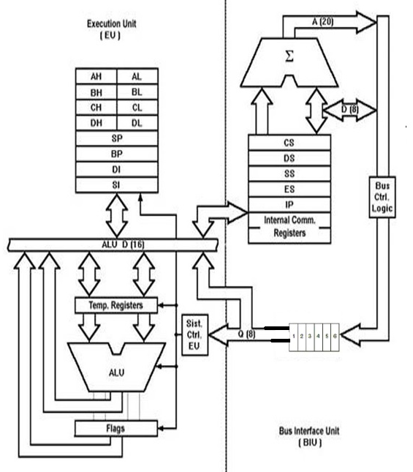
Architecture of 8086
Receives opcode of an instruction from the queue, decodes it and then executes it
While Execution, unit decodes or executes an instruction, then the BIU fetches instruction codes from the memory and stores them in the queue
Independent Functional Units with parallel operation
Data Registers
Pointer Registers
Segment Registers
Index Registers
Instruction Pointer
6 bit instruction queue
Handles transfer of data and addresses
Fetches instruction codes, stores fetched instruction codes in first-in-first-out register set called a queue
Relocates addresses of operands
Reads/Writes data from/to memory and I/O devices
Makes the processor faster

Slide 7

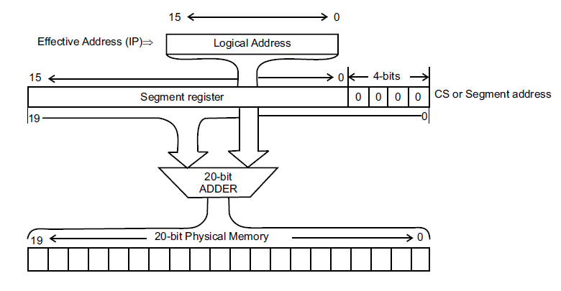
Bus Interface Unit
Instruction Queue: When EU executes instructions, the BIU gets 6-bytes of the next instruction and stores them in the instruction queue and this process is known as instruction pre fetch. This process increases the speed of the processor.
Segment Registers: A segment register contains the addresses of instructions and data in memory which are used by the processor to access memory locations. It points to the starting address of a memory segment currently being used.
Instruction Pointer (IP): It acts as a program counter. It indicates to the address of the next instruction to be executed
16 bit register. Holds instruction codes of a program and base address of memory segment
16 bit register. Data, variables and constants given in the program and logical address of memory segment are held
16 bit register. Holds addresses and data of subroutines. Holds the contents of registers and memory locations given in PUSH instruction and offset address of memory segment
16 bit register. Holds the destination addresses of some data of certain string instructions and starting address of memory segment
Generation of 20 bit physical address from IP

Slide 8
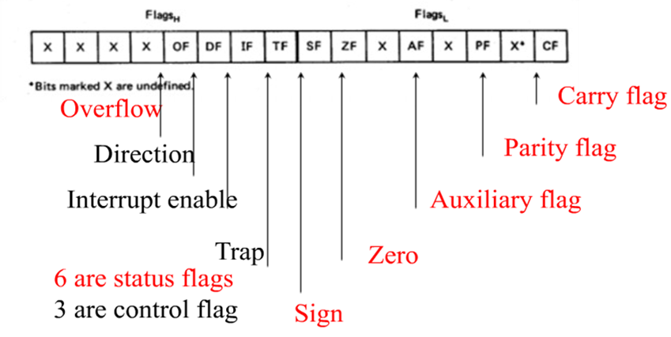
Execution Unit
General Purpose Registers: There are four 16-bit general purpose registers: AX (Accumulator Register), BX (Base Register), CX (Counter) and DX.
Accumulator is involved in most of the I/O and string operations and in operations such as Div,Mult,Shift,Rotate etc.
Base Register can be used as memory pointer in data segment
Counter Register is default counter in loop instructions,string manipulations and used in shift/rotate instructions
Data Register is used in Div,Mult instructions to hold higher word of 32 bit operand and result respectively. Also remainder in Div.
Index Register:Stack Pointer (SP),Base Pointer (BP),Source Index (SI),Destination Index (DI).Hold offset or logical address within a segment.16 bit
ALU: It handles all arithmetic and logical operations. Such as addition, subtraction, multiplication, division, AND, OR, NOT operations
Flag Register: 16 bit register which exactly behaves like a flip-flop, means it changes states according to the result stored in the accumulator. It has 9 flags and they are divided into 2 groups i.e. conditional and control flags

Slide 9
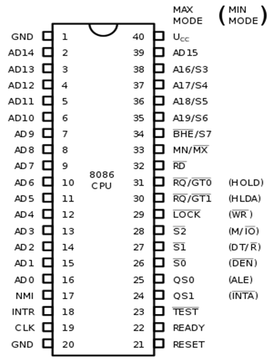
8086 Pin Diagram
BHE/S7 (Output): Bus High Enable/Status. During T1, it is low. It enables the data onto the most significant half of data bus, D8-D15. 8-bit device connected to upper half of the data bus use BHE signal. It is multiplexed with status signal S7. S7 signal is available during T3 and T4.
RD (Read): For read operation. It is an output signal. It is active when LOW.
Ready (Input): The addressed memory or I/O sends acknowledgment through this pin. When HIGH, it denotes that the peripheral is ready to transfer data.
RESET (Input): System reset. The signal is active HIGH.
CLK (input): Clock 5, 8 or 10 MHz
AD0-AD15:Low order address bus. They are multiplexed with data. When used to transmit memory address, the symbol A is used instead of AD
A16-A19 (Output): High order address lines. These are multiplexed with status signals
A16/S3, A17/S4: A16 and A17 are multiplexed with segment identifier signals S3 and S4.
A18/S5: A18 is multiplexed with interrupt status S5.
A19/S6: A19 is multiplexed with status signal S6
INTR: Interrupt Request.
NMI (Input): Non-maskable interrupt request.
TEST (Input): Wait for test control. When LOW the microprocessor continues execution otherwise waits.
VCC: Power supply +5V dc.
GND: Ground
Minimum Mode: One 8086 CPU is to be used
Maximum Mode: Multiprocessor system

Slide 10
Addressing Modes in 8086
The way for which an operand is specified for an instruction in the accumulator, in a general purpose register or in memory location, is called addressing mode/Data Addressing Mode
8086 microprocessors have 8 addressing modes. Of these, two addressing modes have been provided for instructions which operate on register or immediate data
Register Addressing: Operand is placed in one of the 16-bit or 8-bit general purpose registers (Source). Ex. MOV AX, CX, ADD CX, DX
Immediate Addressing: Operand is specified in the instruction itself. Ex. MOV AL, 35H
6 addressing modes specify the location of an operand which is placed in a memory
Direct Addressing: Effective address (Operand's offset) of the memory location is written directly in the instruction.. Ex. ADD AL, [0301]
Register Indirect Addressing: Operand's offset is placed in any one of the registers BX, BP, SI or DI as specified in the instruction. Ex. MOV AX, [BX]
Based Addressing: Operand's offset is the sum of an 8-bit or 16-bit displacement and the contents of the base register BX or BP. BX is used as base register for data segment, and the BP is used as a base register for stack segment. Ex. MOV AL, [BX+05]; (8-bit)
Effective address (Offset) = [BX + 8-bit or 16-bit displacement].
Indexed Addressing: Offset of an operand is the sum of the content of an index register SI or DI and an 8-bit or 16-bit displacement. Ex. MOV AX, [SI + 1528H]; (16-bit displacement).
Based Indexed Addressing: The offset of operand is the sum of the content of a base register BX or BP and an index register SI or DI. Ex. ADD AX, [BX + SI]
Based Indexed with Displacement: Operand's offset is given by adding the base register contents
Effective Address (Offset) = [BX or BP] + [SI or DI] + 8-bit or 16-bit displacement
Ex. MOV AX, [BX + SI + 05]; 8-bit displacement

Slide 11
Address Addressing Modes in 8086
These indicates the branch address in CALL and JUMP Instructions. Used for Control Transfer Instructions
Addressing Mode
Intersegment
Intrasegment
Direct
Indirect
Direct
Indirect

Slide 12
Memory Segmentation in 8086
Process in which the main memory of the computer is logically divided into different segments and each segment has its own base address
To enhance the speed of execution of the computer system, so that the processor is able to fetch and execute the data from the memory easily and fast.
BIU contains four 16 bit special purpose registers called as Segment Registers
Code segment register (CS): Used for addressing memory location in the code segment of the memory, where the executable program is stored.
Data segment register (DS): Points to the data segment of the memory where the data is stored.
Extra Segment Register (ES): Also refers to a segment in the memory which is another data segment in the memory.
Stack Segment Register (SS): Used for addressing stack segment of the memory. The stack segment is that segment of memory which is used to store stack data.
To enhance the speed of execution of the computer system, so that the processor is able to fetch and execute the data from the memory easily and fast.
BIU sends 20bit address, so as to access one of the 1MB memory locations
Four segment registers actually contain the upper 16 bits of the starting addresses of the four memory segments of 64 KB each with which the 8086 is working at that instant of time. May be up to 64 kilobytes long
8086 does not work the whole 1MB memory at any given time. However, it works only with four 64KB segments within the whole 1MB memory.
Starting address will always be changing. It will not be fixed.

Slide 13
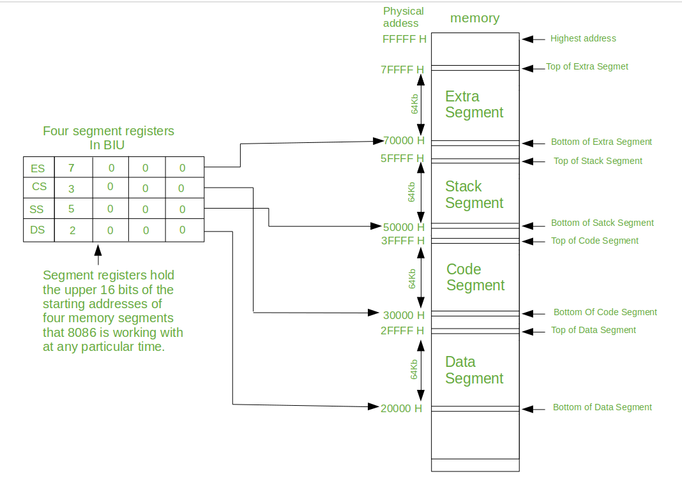
Memory Segmentation in 8086

Slide 14

Types of Segmentation
Overlapping Segment – A segment starts at a particular address and its maximum size can go up to 64kilobytes. But if another segment starts along with this 64kilobytes location of the first segment, then the two are said to be Overlapping Segment.
Non-Overlapped Segment – A segment starts at a particular address and its maximum size can go up to 64kilobytes. But if another segment starts before this 64kilobytes location of the first segment, then the two segments are said to be Non-Overlapped Segment
Rules of Segmentation
The starting address of a segment should be such that it can be evenly divided by 16.
Minimum size of a segment can be 16 bytes and the maximum can be 64 kB
Advantages of Segmentation
It provides a powerful memory management mechanism.
Data related or stack related operations can be performed in different segments.
Code related operation can be done in separate code segments.
It allows to processes to easily share data.
It allows to extend the address ability of the processor, i.e. segmentation allows the use of 16 bit registers to give an addressing capability of 1 Megabytes. Without segmentation, it would require 20 bit registers.
It is possible to enhance the memory size of code data or stack segments beyond 64 KB by allotting more than one segment for each area

Slide 15
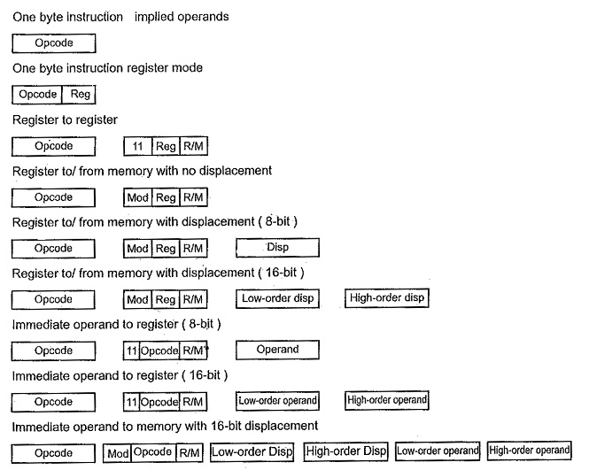
8086 Instruction Format
The opcode/addressing mode byte(s) may be followed by :
No additional byte
Two byte EA (For direct addressing only).
One or two byte displacement
One or two byte immediate operand
One or two byte displacement followed by a one or two byte immediate operand
Two byte displacement and a two byte segment address (for direct intersegment addressing only)
8086 Instruction Format vary from 1 to 6 bytes in length

Slide 16
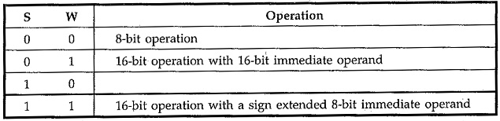
8086 Instruction Format
Most of the opcodes in 8086 has a special 1-bit indicates
W-bit : Some instructions of 8086 can operate on byte or a word. The W-bit in the opcode of such instruction specify whether instruction is a byte instruction (W = 0) or a word instruction (W = 1).
D-bit : The D-bit in the opcode of the instruction indicates that the register specified within the instruction is a source register (D = 0) or destination register (D =1).
S-bit : An 8-bit 2’s complement number can be extended to a 16-bit 2’s complement number by making all of the bits in the higher-order byte equal the most significant bit in the low order byte. This is known as sign extension. The S-bit along with the W-bit indicate operations mentioned below
V-bit : V-bit decides the number of shifts for rotate and shift instructions. If V = 0, then count = 1; if V = 1, the count is in CL register. For example, if V = 1 and CL = 2 then shift or rotate instruction shifts or rotates 2-bits
Z-bit : It is used for string primitives such as REP for comparison with ZF Flag

Slide 17
Maximum and Minimum Mode Configuration
In minimum mode,8086 is the only processor in the system which provides all the control signals which are needed for memory operations and I/O interfacing.
Here the circuit is simple but it does not support multiprocessing.
The other components which are transceivers, latches, 8284 clock generator, 74138 decoder, memory and i/o devices are also present in the system.
The address bus of 8086 is 20 bits long. By this we can access 2²⁰ byte memory i.e. 1MB . Out of 20 bits, 16 bits A₀ to A₁₅(or 16 lines) are multiplexed with a data bus. By multiplexing, it means they will act as address lines during the first T state of the machine cycle and in the rest, they act as data lines. A₁₆ to A₁₉ are multiplexed S₃ to S₆ and BHE’ is multiplexed with S₇.
HOLD
This is a control signal sent by the connected external peripheral device to acquire the microprocessor buses. If an external device like the input and output devices are connected to the 8086 microprocessor and they require the control over the buses, then a HOLD signal is sent by that device at this pin.
HLDA
After the control of buses is transferred to the external peripheral device, then an acknowledgment signal is sent for the same through this pin.
WR'
This signal is used for writing purpose. It is an active low signal.
M / IO'
This pin tells whether the operation is performed in the memory or through the IO devices. If this pin is 1, then the operations are performed in memory, else in the IO devices.
DT / R'
This signal tells whether the data is transferred or received. The microprocessor transfers the data when the pin is at 1, and at 0, it receives data.
DEN'
DEN stands for Data Enable. This pin is used to activate a chip in case of multiple chips. It is an active low signal.
ALE
This pin is used to Latch address from multiplexed bus to temporary storage in the 8086 microprocessor. If this pin is set to high, then the AD0 to AD15 pins will carry address, else they will carry data in them.
INTA
INTA stands for interrupt acknowledgment. If an interrupt request is received at INTR, then the acknowledgment for it is sent through this pin
The pin 33 decides whether the processor will work in minimum mode or maximum mode. If the pin is set, then the minimum mode is followed, else the processor works in maximum mode.

Slide 18
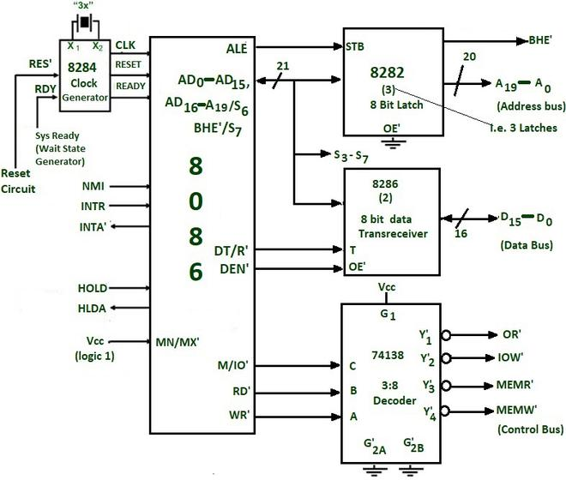
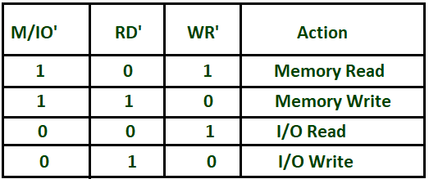
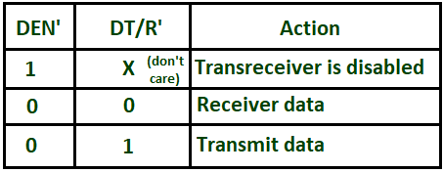
Control signals provided by 8086 for memory operations and i/o interfacing are used to identifying whether the bus is carrying a valid address or not , in which direction data is needed to be transferred over the bus, when there is valid write data on the data bus and when to put read data on the system bus
8282 (8 bits) latch : The latches are buffered D FF. They are used to separate the valid address from the multiplexed Address/data bus by using the control signal ALE, which is connected to strobe(STB) of 8282. The ALE is active high signal. Here three such latches are required because the address is 20 bits.
8286 (8 bits) transceivers : They are bidirectional buffers and also known as data amplifiers. They are used to separate the valid data from multiplexed add/data bus. Two such transceivers are needed because the data bus is 16 bits long. 8286 is connected to DT/R’ and DEN’ signals. They are enabled through the DEN signal .The direction of data on the data bus is controlled by the DT/R’ signal. DT/R’ is connected to T and DEN’ is connected to OE’.
8284 clock generator is used to provide the clock.
Control signals for all operations are generated by decoding M/IO’, RD’, WR’. They are decoded by 74138 3:8 decoder
Minimum Mode Circuit

Slide 19
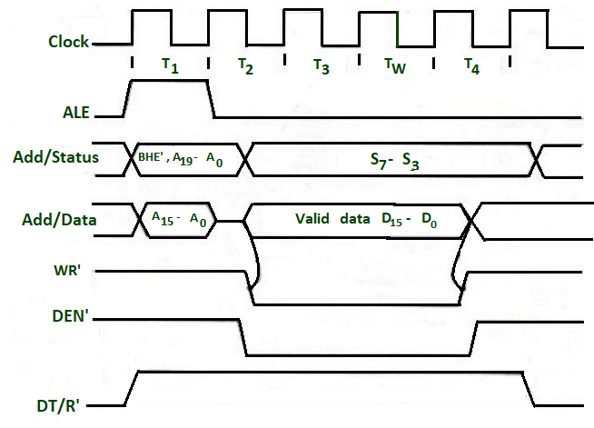
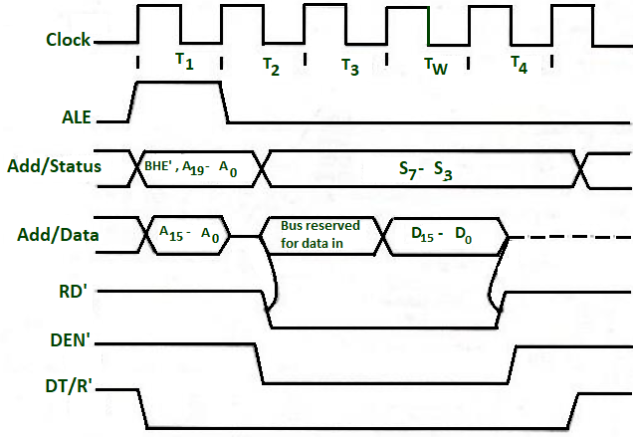
Timing Diagram Minimum Mode
All processors bus cycle is of at least 4 T-states(T₁,T₂,T₃,T₄) .The address is given by processor in the T1 state. It is available on the bus for one T-state.
In T_{2,} the bus is tristated for changing the direction of the bus( in the case of a data read cycle.)
The data transfer takes place between T₃ and T₄.
If the addressed device is slower, then the wait state is inserted between T₃ and T₄.
Opcode fetch or read timing diagram
Write memory cycle
At T₁ state ALE =1 ,this indicates that a valid address is latched on the address bus and also M / IO’= 1, which indicates the memory operation is in progress.
In T₂, the address is removed from the local bus and is sent to the addressed device. Then the bus is tristated.
When RD’ = 0 , the valid data is present on the data bus.
During T₂ DEN’ =0, which enables transceivers and DT/R’ = 0 ,which indicates that the data is received.
During T_{3,} data is put on the data bus and the processor reads it.
The output device makes the READY line high. This means the output device has performed the data transfer process. When the processor makes the read signal to 1, then the output device will again tristate its bus drivers
At T₁ state ALE =1 ,this indicates that a valid address is latched on the address bus and also M / IO’= 1, which indicates the memory operation is in progress.
In T₂, the processor sends the data to be written to the addressed location.
The data is buffered on the bus until the middle of T₄ state.
The WR’=0 becomes at the beginning of T₂.
The BHE’ and A0 signals are used to select the byte or bytes of memory or I/O word.
During T₂ DEN’ =0, which enables, transceivers and DT/R’ = 1 ,which indicates that the data is transferred by the processor to the addressed device

Slide 20
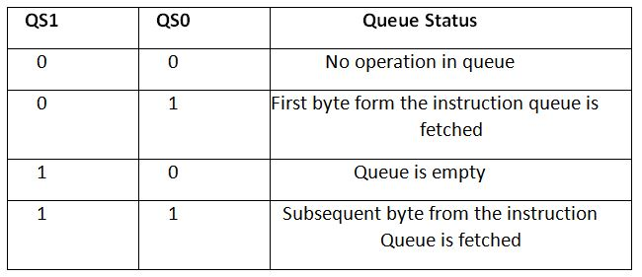
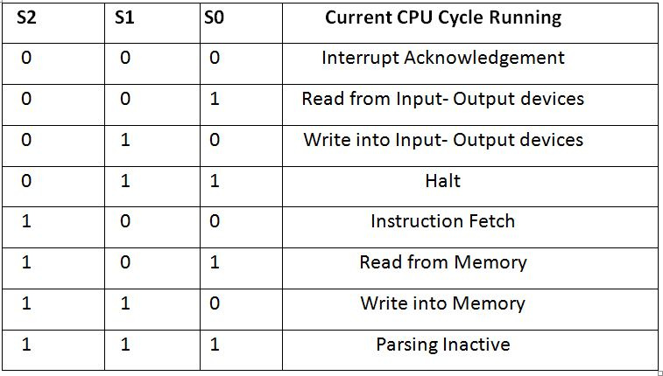
Maximum Mode
(RQ' / GT 0) and (RQ’ / GT 1)
These two pins are used for bus request and grant purpose. Through these pins, a connection is established between the external peripheral devices and the 8086 microprocessor. Among these two pins, the pin- (RT / GT 0) has higher priority over (RT / GT 1).
LOCK'
This pin is used to lock the internal buses of the microprocessor. When the control of buses is handed over to an external peripheral device, then the microprocessor is locked through this pin. It is an active low signal.
QS0 and QS1
QS stands for Queue status, and as the name suggests, these two pins are used to tell the status of the queue
S2, S1 and S0
Here, the S in each of these pins stands for Status. These three pins: S2, S1, and S0 together tell about the CPU cycle. The different of the values of these pins taken together tell about which CPU cycle is currently running
When the pin 33 of the 8086 microprocessor is in the reset state, i.e. 0, then the microprocessor functions in the Maximum Mode.

Slide 21
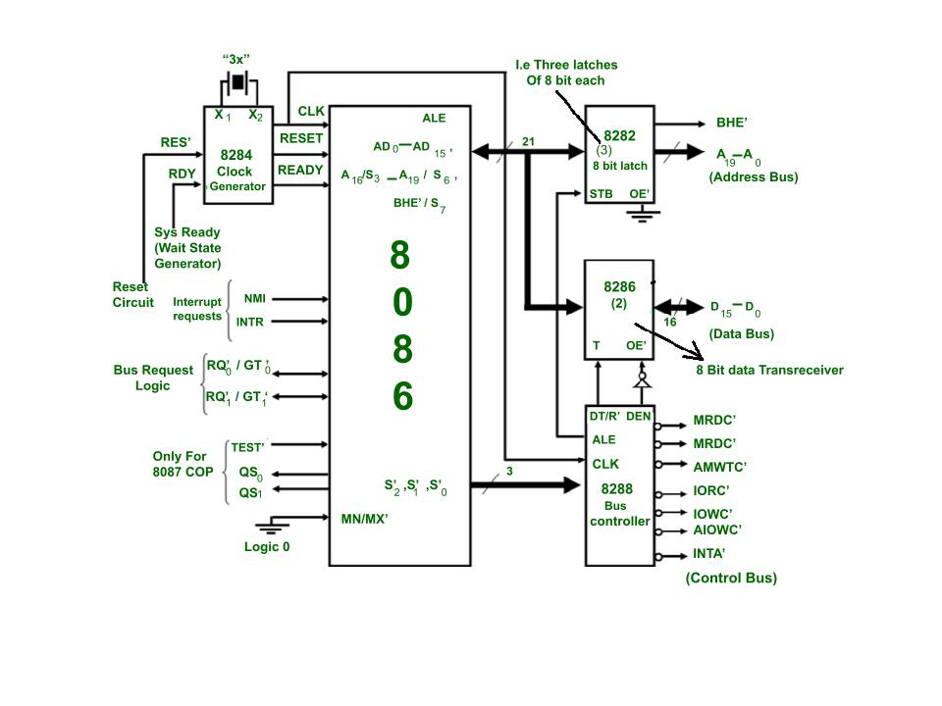
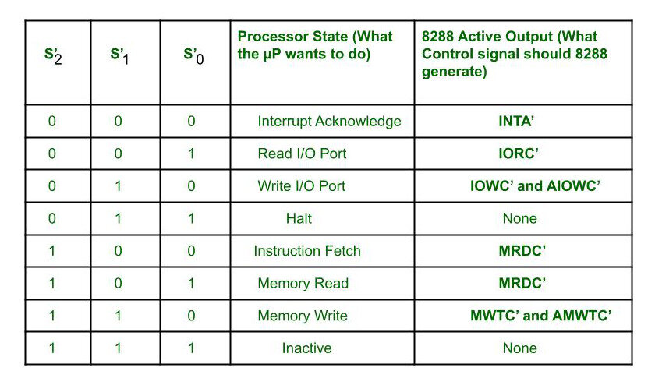
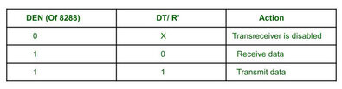
We can connect more processors to 8086 (8087/8089).
8086 max mode is basically for implementation of allocation of global resources and passing bus control to other coprocessor(i.e. second processor in the system), because two processors can not access system bus at same instant.
All processors execute their own program.
The resources which are common to all processors are known as global resources.
The resources which are allocated to a particular processor are known as local or private resources
Control signals for all operations are generated by decoding S’₂, S’₁ and S’₀ using 8288 bus controller
Bus request is done using RQ’ / GT’ lines interfaced with 8086. RQ0/GT0 has more priority than RQ1/GT1.
INTA’ is given by 8288, in response to an interrupt on INTR line of 8086.
In max mode, the advanced write signals get enabled one T-state in advance as compared to normal write signals. This gives slower devices more time to get ready to accept the data, therefore it reduces the number of cycles
Clock is provided by 8284 clock generator.
8288 bus controller- Address form the address bus is latched into 8282 8-bit latch. Three such latches are required because address bus is 20 bit. The ALE(Address latch enable) is connected to STB(Strobe) of the latch. The ALE for latch is given by 8288 bus controller.
The data bus is operated through 8286 8-bit transceiver. Two such transceivers are required, because data bus is 16-bit. The transceivers are enabled the DEN signal, while the direction of data is controlled by the DT/R signal. DEN is connected to OE’ and DT/ R’ is connected to T. Both DEN and DT/ R’ are given by 8288 bus controller
ADV: It supports multiprocessing, Therefore it helps to increase the efficiency.
DISADV: More complex circuit than min mode

Slide 22
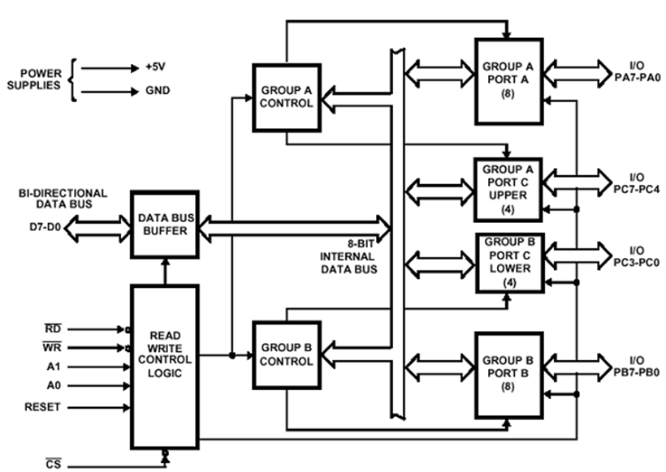
Programmable Peripheral Interface
To communicate with the outside world microcomputers use peripherals (I/O devices). Commonly used peripherals are: A/D converter, D/A converter, CRT, printers, Hard disks, floppy disks, magnetic tapes etc.
Peripherals are connected to the microcomputer through electronic circuits known as interfacing circuits.
A programmable peripheral interface is a multiport device. The ports may be programmed in a variety of ways as required by the programmer. The device is very useful for interfacing peripheral devices.
Intel 8255
It has two versions, namely the Intel 8255A and Intel 8255A-5. General descriptions for both are same but there exists some differences in electrical characteristics
It has three 8-bit ports, namely Port A, Port B and Port C.
Port C has been further divided into two 4-bit ports, port C upper and Port C lower. Thus a total of 4-ports are available, two 8-bit ports and two 4-bit ports.
Each port can be programmed either as an input port or an output port.
8255 Architecture

Slide 23
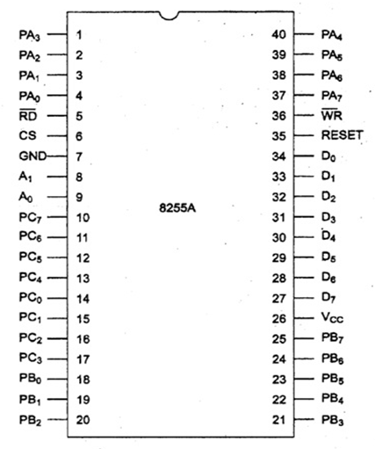
Operating Modes of 8255
Mode 0 - Simple Input/output: The 8255 has two 8-bit ports (Port A and Port B) and two 4-bit ports (Port C_{upper} and Port C_{lower}). In Mode 0 operation, a port can be operated as a simple input or output port. Each of the 4 ports of 8255 can be programmed to be either an input or output port.
Mode 1-Strobed Input/output: Mode 1 is strobed input/output mode of operation. The Port A and Port B both are designed to operate in this mode of operation. When Port A and Port B are programmed in Mode 1, six pins of Port C are used for their control.
Mode 2 -Bidirectional Port: Mode 2 is strobed bidirectional mode of operation. In this mode Port A can be programmed to operate as a bidirectional port. The mode 2 operation is only for Port A. When Port A is programmed in Mode 2, the port B can be used either Mode 1 or Mode 0
Operates on a single 5 V_{d.c.} supply
Control Signals
CS (Chip Select): It is a chip select signal. The LOW status of this signal enables communication between the CPU and 8255.
RD (READ): When RD goes LOW the 8255 sends out data or status information to the CPU on the data bus. In other words it allows the CPU to read data from the input port of 8255.
WR (Write): When WR goes LOW the CPU writes data or control word into 8255. The CPU writes data into the output port of 8255 and the control word into the control word register.
RESET: RESET is an active high signal. It clears the control register and sets all ports in the input mode.
A0 and A1: The selection of input port and control word register is done using A0 and A1 in conjunction with RD and WR. A0 and A1 are normally connected to the least significant bits of the address bus
PA₀ - PA₇ :8 Pins of port A PB₀ - PB₇ :8 pins of port B PC₀ - PC₃ :4 pins of port C_{lower} PC₄ - PC₇ :4 pins of Port C_{upper}
8255 Pin Diagram

Slide 24
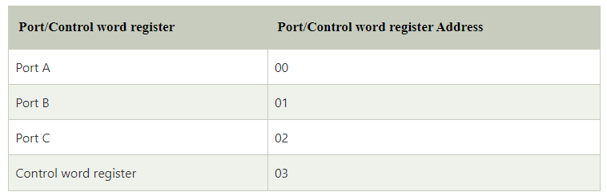
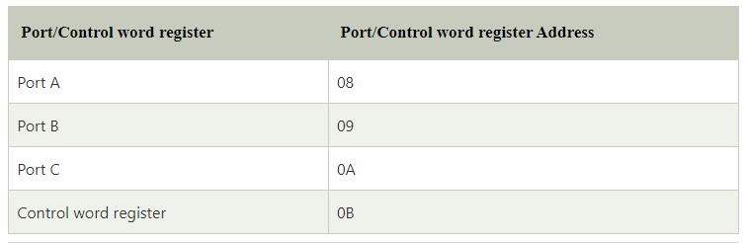
1st Unit
2nd Unit

Slide 25
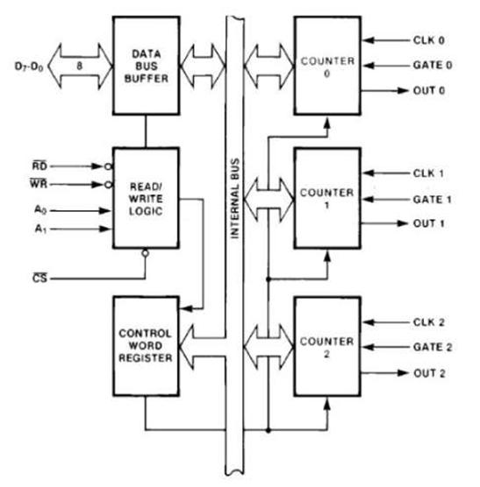
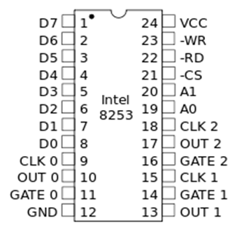
Programmable Timer Controller
Used in real time application for timing and counting function such as BCD/binary counting, generation of accurate time delay, generation of square wave of desired frequency, rate generation, hardware/software triggered strobe signal, one shot signal of desired width etc
Intel 8253 and 8254:Both are pin to pin compatible and operate in six modes
Mode 0: Interrupt on terminal count
Mode 1: Programmable one-shot
Mode 2: Rate generator
Mode 3: Square wave generator
Mode 4: Software triggered mode
Mode 5: Hardware triggered mode
Note: The 8254 is compatible to 8086, 8088, 8085 and most other microprocessors
24-pin IC and operates at 5 Vd.c.. It contains three independent 16-bit counters. The programmer can program 8253 to operate in any one of the 6 operating modes. It operates under software control.
8254 Architecture
8254 Pin Diagram

Slide 26
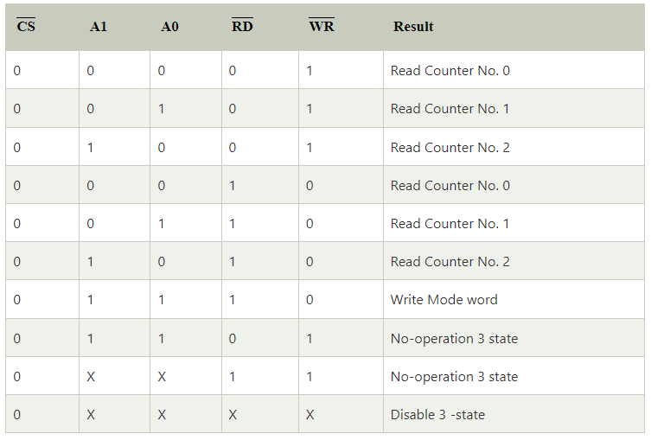
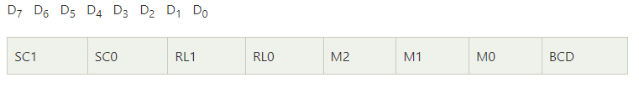
RD (Read): When this pin is LOW the CPU reads data.
¯WR: (Write): When this is low, the CPU outputs data in the form of mode information or loading of counters.
A₀, A1: These pins are connected to the address bus. These are used to select one of three counters. These are also used to address the control word registers for mode selection.
CS: Chip Select.
D₀ - D₇: Bidirectional data bus.
CLK₀, CLK₁ and CLK₂ are clock for Counter 0, Counter 1 and Counter 2 respectively.
GATE₀, GATE₁ and GATE₂ are gate terminals of Counter 0, Counter 1 and Counter 2 respectively.
OUT₀, OUT₁ and OUT₂ are output terminals of Counter 0, Counter 1 and Counter 2 respectively.
The 8254 contains a data buffer, read/write logic and control word register as described below:
Data Bus Buffer: This buffer is within 8254. It is a 3-state, bidirectional, 8-bit buffer. It is used to interface 8254 to the system data bus through D₀ - D₇ lines.
Read/Write logic: The 8254 contains a read/write logic which accepts input from the system bus and then generates control signals for the operation
Counter Word Register: When the pins A0, A1 are 11, the control word register is selected.

Slide 27
8254 Operational Modes
The bits D₇ and D₆ of the control word are to select one of the 3 counters. D₅ and D₄ are for loading/reading the count. D₃, D₂ and D₁ are for the selection of operating mode of the selected counter.
These are six modes of operation for each counter of 8254. The six modes of operation are: MODE 0, MODE 1, MODE 2, MODE 3, MODE 4 and MODE 5. The bit D0 is for the selection of binary or BCD counting.
MODE 0 : Interrupt on Terminal Count
Used for the generation of accurate time delay under software control.
One of the counters of 8253 is initialized and loaded with suitable count for the desired time delay.
When counting is finished the counter interrupts the CPU. On interruption the microprocessor performs the required task which is to be performed after the desired time delay.
For MODE 0 operation GATE is kept high. While counting is going on the counter output OUT remains LOW. When the terminal count is reached i.e. count reaches 0, the output becomes HIGH until the count is reloaded or new count is loaded.
When the count is reloaded or OUT becomes LOW and the counter starts its counting operation again.
MODE 1 : Programmable One-Shot
In MODE 1 the counter acts as a retriggerable and programmable one-shot.
The LOW to HIGH transition of the signal applied to GATE acts as a trigger signal.
In this mode of operation OUT becomes initially HIGH after the mode is set. After mode set operation the counter is loaded by a count value of N. The counter decrements count, and the output (OUT) goes LOW for N clock cycles for every LOW to HIGH transition of the GATE input.

Slide 28
MODE 2 : RATE Generator
In MODE 2 the counter acts as a simple divide by N counter.
When this mode is set the output of the counter becomes initially HIGH.
After mode set operation the counter is loaded by a count of value N.
For MODE 2 operation GATE is kept HIGH.
In this mode the output remains HIGH for (N-1) clock pulses and then goes LOW for one clock pulse.
MODE 3 : Square Wave Generation
In MODE 3 the counter acts as a square wave generator. After mode set operation the counter is loaded by a count of value N.
For MODE 3 operation GATE is kept HIGH.
For even values of N the output remains HIGH for N/2 clock pulses abd then goes LOW for next N/2 clock pulses
MODE 4 : Software Triggered Strobe
In MODE 4 operation the output of the counter becomes initially HIGH after the mode is set.
GATE is kept HIGH for this mode of operation. The counter begins counting immediately after the count is loaded into the count register.
When the counter reaches terminal count (i.e. counter content = 0) the output goes LOW for one clock period, then it returns to HIGH.
The output signal may be used as strobe.
This mode of operation is referred to as a software triggered strobe because the generation of the strobe signal is triggered by loading the count into the count register.
MODE 5 : Hardware Triggered Strobe
In this mode of operation GATE input acts as a trigger.
After the mode is set, the output becomes initially HIGH.
A count value of N is loaded into the counter.
Following a LOW to HIGH transition of the GATE input the counter starts decrementing the count.
The counting begins at the first negative edge of the clock after the rising edge of the GATE input.
On terminal count the output goes LOW for one clock period, and then it goes HIGH again.
As the LOW to HIGH transition of the GATE input causes triggering, this mode is referred to as hardware triggered strobe.

Slide 29
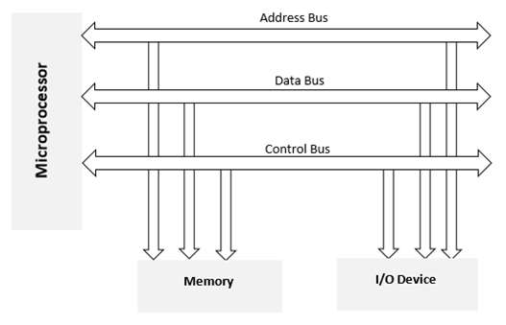
Memory Interfacing
To interface the memory with 8086, we need the system bus and the control signals for memory read and write operations
Four common types of memory:
Read only memory (ROM)
Flash memory (EEPROM)
Static Random access memory (SARAM)
Dynamic Random access memory (DRAM).
When we are executing any instruction, the address of memory location or an I/O device is sent out by the microprocessor. The corresponding memory chip or I/O device is selected by a decoding circuit.
Memory requires some signals to read from and write to registers and microprocessor transmits some signals for reading or writing data
Interfacing process includes matching the memory requirements with the microprocessor signals.
Therefore, the interfacing circuit should be designed in such a way that it matches the memory signal requirements with the microprocessor's signals.
8 bit data line, 16 bit address line , control signals are connected to corresponding lines of memory IC.
Address connections: All memory devices have address inputs that select a memory location within the memory device. Address inputs are labeled (A0 –An)
Data connections: All memory devices have a set of data outputs or
input/outputs. Today many of them have bi-directional common I/O pins.
Selection connections: Each memory device has an input that selects or enables the memory device. This kind of input is most often called a chip select (CS)
Control connections: The control input most often found on the ROM is the output enable (OE) or gate (G) this allows data to flow out of the output data pins of the ROM.

Slide 30
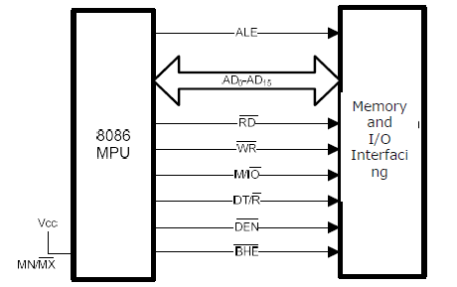
Minimum Mode Memory Interfacing
Address bus & Data bus are multiplexed on same lines (AD0 to AD15).
During first clock cycle, it serves as a memory/ IO address bus.
For second and third clock cycles it acts as data bus and carries data.
Demultiplexing refers to separating Address & Data signals for read/write operations.
Block Diagram

Slide 31
THANK YOU

